Slide 1
Ggplot2 and interactive graphics with R
Christophe Ladroue
SECTION 06
Making interactive webpages with ‘shiny’
www.PacktPub.com

Slide 2
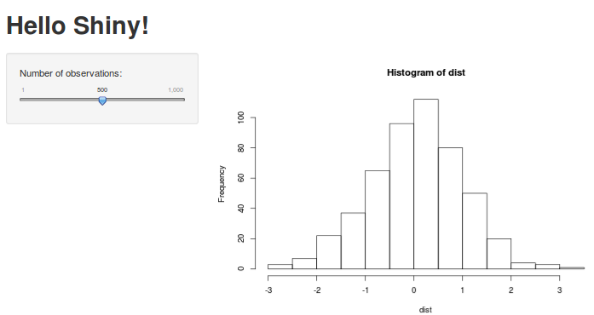
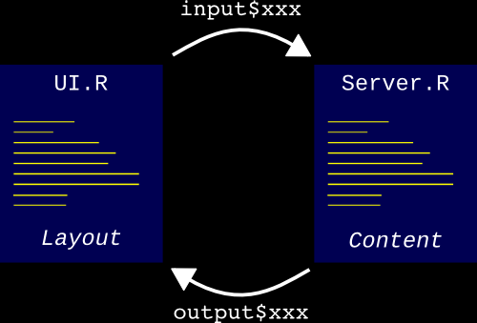
In this video we took a look at
how to install the R package ‘shiny’
a first example of an interactive webpage.
Next: the structure of a shiny app

Slide 3
In this section we’re going to take a look at
creating interactive webpages with Shiny.
understanding the structure of a shiny app.
rendering text
understanding reactive programming
using a button to avoid frequent updates

